Slide 1
Lab on cell-free synthetic biology
Week 3
Maerkl Lab
September 2025
EPFL

Slide 2
Today’s tasks
Aim: Compare different protein production methods
Cell density measurement by spectrophotometry
Protein expression in E. coli
SDS-PAGE

Slide 3
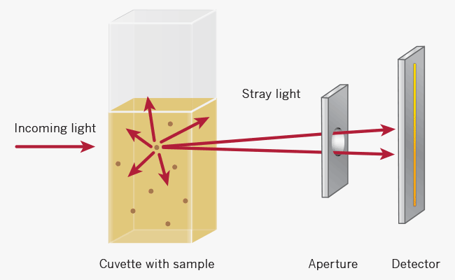
Cell density measurement by spectrophotometry
Principle: Measure cell concentration by detecting light scattering from a cell suspension
2. Light scattering (prevents from reaching the detector)
3. Detector (sensor measures amount of light not scattered but that is transmitted, compared to blank)
1. Incoming light (600 nm)
4. Output: optical density (OD_{600 nm} measures how much light scattered by cells)
https://www.implen.de/od600-diluphotometer/od600/

Slide 4
Cell density measurement by spectrophotometry
Determine cell concentration:
Limitations:
Depends on light scattering, much less on light absorbance
  Beer-Lambert law not accurate for high-cell density
  Linear correlation fades with high cell concentration (>1.2 OD_{600 nm} )
OD_{600 nm} depends on optical setup (distance between the cell holder and instrument exit slit, monochromator optics, slit geometry, etc.)
  Different instruments give different results
OD_{600 nm} depends on cell shape and size
  Similar cell concentrations of different cells may give the same OD_{600 nm}
OD600 nm correlates positively with cell density
Standard curve to determine unknown cell concentration, based on experimental data (OD versus cell count)
  Example factor: 1 OD600 nm equivalent to 8 x 10^8 E. coli cells/mL
https://www.sigmaaldrich.com/deepweb/assets/sigmaaldrich/product/documents/426/740/sq-cell-density-od600-appnote-mk.pdf

Slide 5
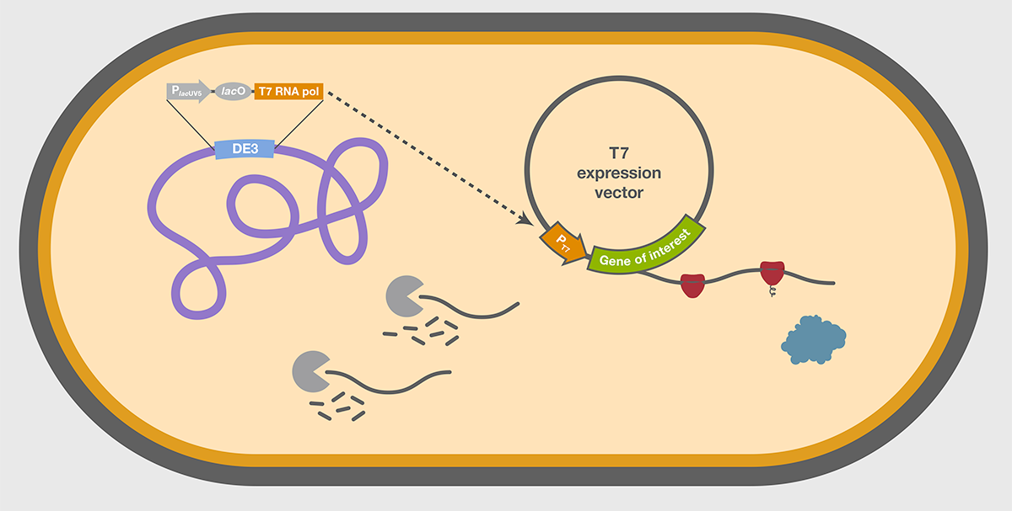
Protein expression in E. coli
https://www.thermofisher.com/ch/en/home/life-science/cloning/cloning-learning-center/invitrogen-school-of-molecular-biology/molecular-cloning/transformation/competent-cell-selection-applications.html

Slide 6
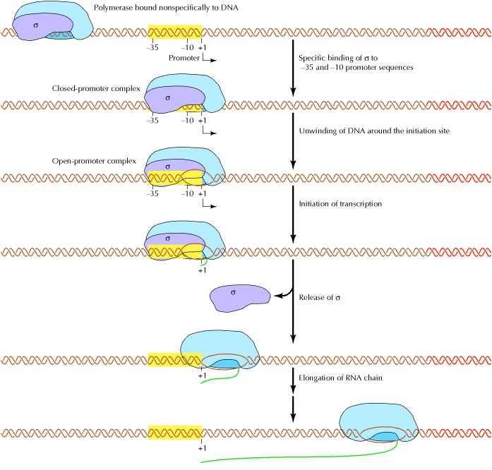
Protein expression in E. coli: basic requirements (on plasmid)
Transcription:
  Promoter: recognition site of RNA-polymerase
  Gene of interest
  Terminator: signals end of transcription
The Cell: a Molecular Approach. 2nd edtion, https://www.ncbi.nlm.nih.gov/books/NBK9850/

Slide 7
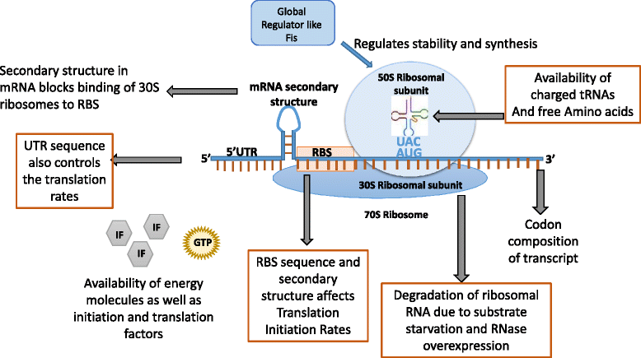
Protein expression in E. coli: basic requirements (on plasmid)
Translation:
  Ribosome binding site (binding site of 16S RNA)
  Start codon(s)
  Stop codons
Mahalik et al., 2014, https://microbialcellfactories.biomedcentral.com/articles/10.1186/s12934-014-0177-1/figures/3

Slide 8
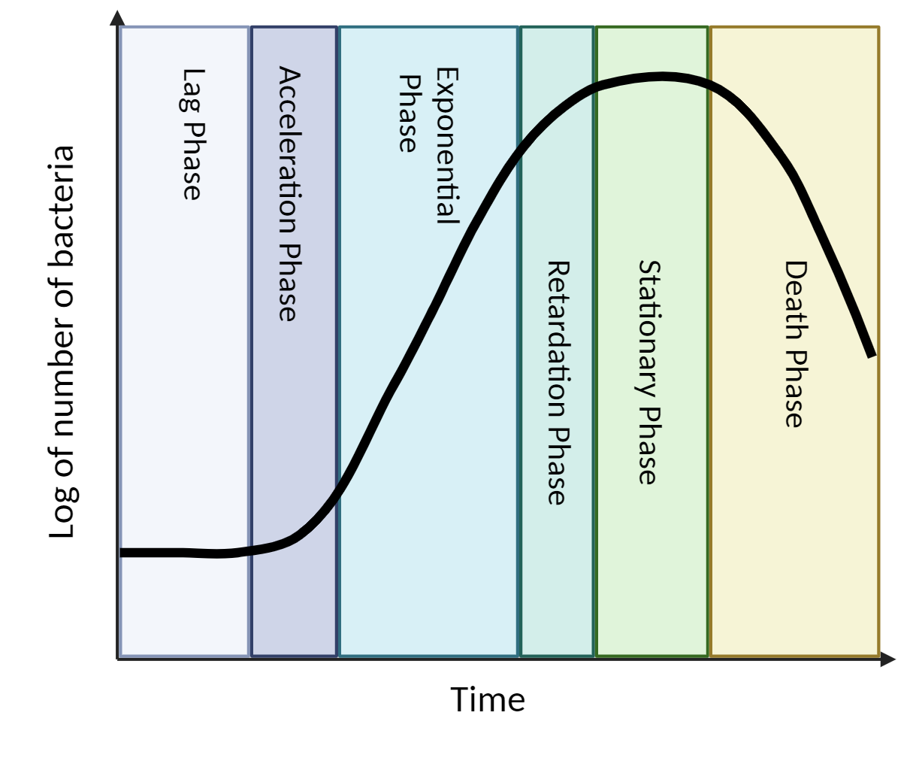
Protein expression in E. coli: growth curve
Highest protein production
yield: from mid-log phase (OD_{600 nm} 0.4 for E. coli)
https://www.thermofisher.com/ch/en/home/life-science/cloning/cloning-learning-center/invitrogen-school-of-molecular-biology/molecular-cloning/transformation/competent-cell-selection-applications.html

Slide 9
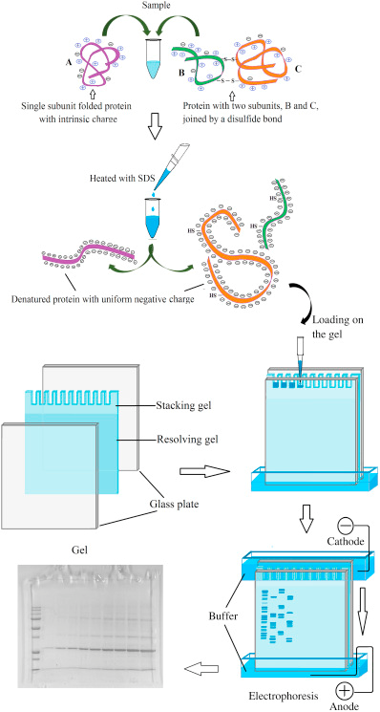
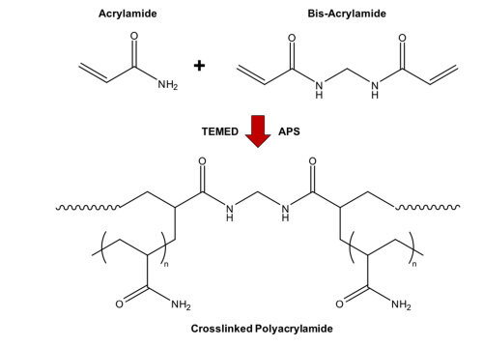
Gel electrophoresis for proteins
Definition: standard laboratory technique by which proteins are separated by size
(and charge)
Use: Compare production yields, confirm presence/absence, assess purity of sample,
proteomics, etc.
Principle (SDS-PAGE):
Sample preparation:
Gel: acrylamide + bisacrylamide + ammonium persulfate (APS, polymerizing agent)
-> polyacrylamide
Stacking gel: gel that stacks into a tight band before separation
Resolving gel: gel that separates proteins based on size
Sample buffer: buffer/solution where sample is (proteins)
Stacking gel buffer: buffer within stacking gel
Resolving gel buffer: buffer within resolving gel
Running buffer: buffer within gel tank
Note: other types of PAGE exist (native PAGE, 2D-PAGE, etc.)
https://www.excedr.com/resources/protein-gel-electrophoresis
Huang et al., 2018, https://www.researchgate.net/figure/Gelation-mechanism-of-polyacrylamide-hydrogels-Ammonium-persulfate-APS-acts-as-a_fig1_322216388

Slide 10
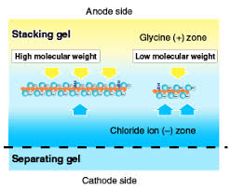
Gel electrophoresis for proteins
Gel parameters:
Higher polyacrylamide concentration -> smaller pores -> resolve smaller proteins
Lower polyacrylamide concentration -> bigger pores -> resolve bigger proteins
Concentration of substrates and time of polymerization inversely correlates with pore size
Two systems:
Laemmli: less expensive, homemade ; Bis-Tris: higher resolution, better protein stability
Stacking effect:
 | Laemmli system | Bis-Tris system
Gel | polyacrylamide, Tris-HCl (pH 6.8 or 8.8), SDS | polyacrylamide (gradient), Bis-Tris (pH 6.4-7.0), SDS
Sample buffer | SDS, glycerol, tris-HCl, DTT, dye | SDS, glycerol, tris-HCl, DTT, dye (and more…)
Stacking gel buffer | Tris-HCl (pH 6.8) | Bis-Tris (pH 6.4-7)
Resolving gel buffer | Tris-HCl (pH 8.8)
Running buffer | Tris, glycine, SDS | MOPS/MES,Tris, SDS, EDTA
Proteins electrophoretic mobility between Cl⁻ and glycine
Proteins compressed in narrow zone between the 2 fronts due to generated electric field
MES: better for small proteins, MOPS: better for big proteins
https://www.mblbio.com/bio/g/support/method/sds-page.html

